Slide 1
Arduino Course Session One
Overview of the Course and the Arduino platform

Slide 2
Why Learn Arduino (Embedded Programming)
Easy Integration into any field
Introduction to programming and electrical enginereeing
Nice Hobby

Slide 3
Objectives of This Course
Arduino Uno layout
Using Arduino IDE
Programming Basics
Arduino digital INPUT/OUTPUT functions
Arduino analog INPUT/OUTPUT functions
Using Common Sensors
Controlling Motors

Slide 4
Objectives of This Course
Learning how to use new component using online resource (without trainer help)
Arduino Communication Protocols (how Arduino communicate with other Arduino boards, complex sensors and modules)

Slide 5
Session 1 - Introduction to Arduino
Downloading Arduino IDE
Arduino Overview
Arduino Uno Layout
Overview of Electrical Components
Setting Up Arduino IDE
Setting Up Tinkercad (Arduino simulator)

Slide 6
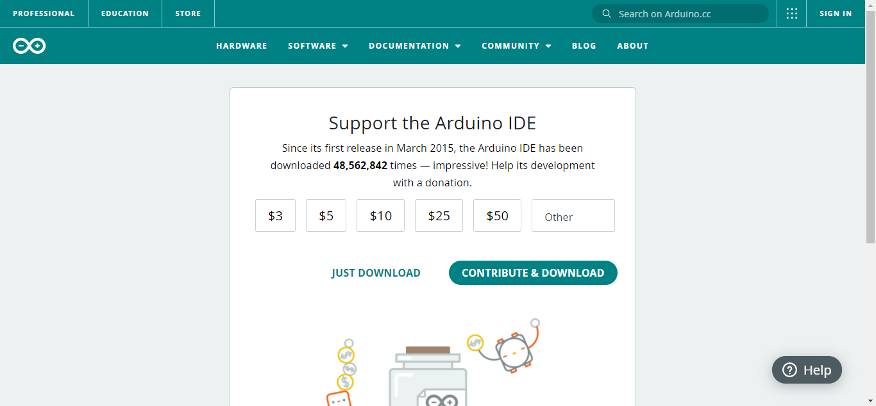
Installing Arduino IDE

Slide 7
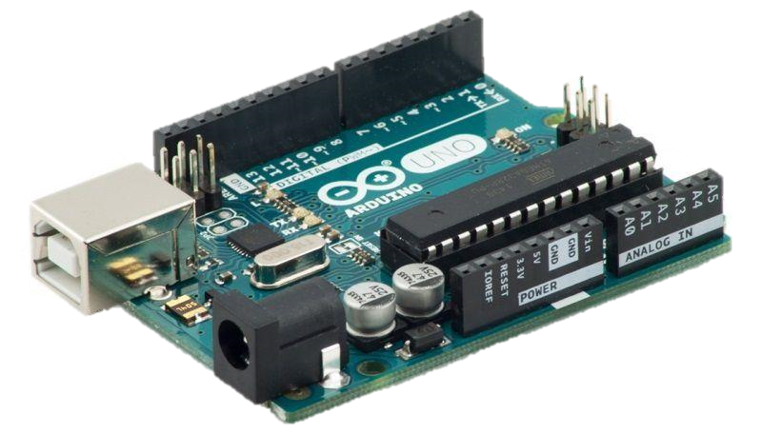
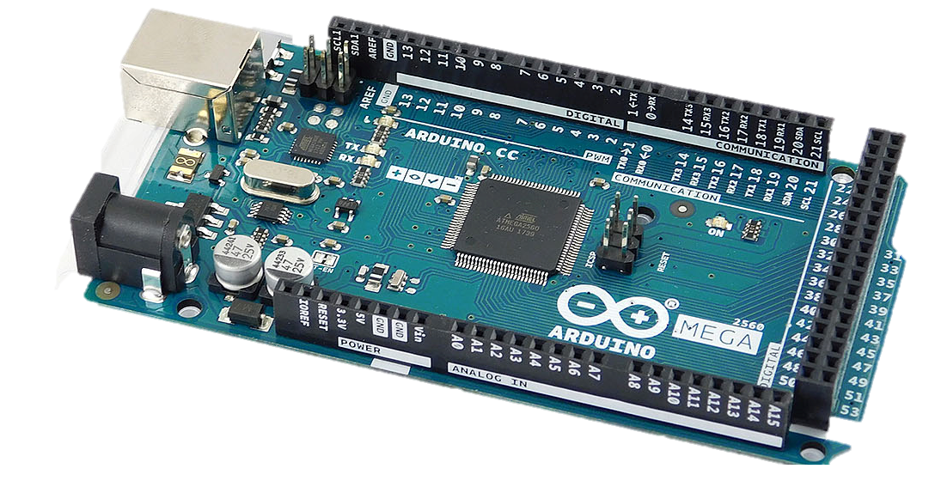
What is Arduino
Programmable Electronic Platform
Microcontrollers (like Arduino, Teensy, STM32), SBC (single board computers like raspberry pi), FPGA (field programmable gate array)

Slide 8
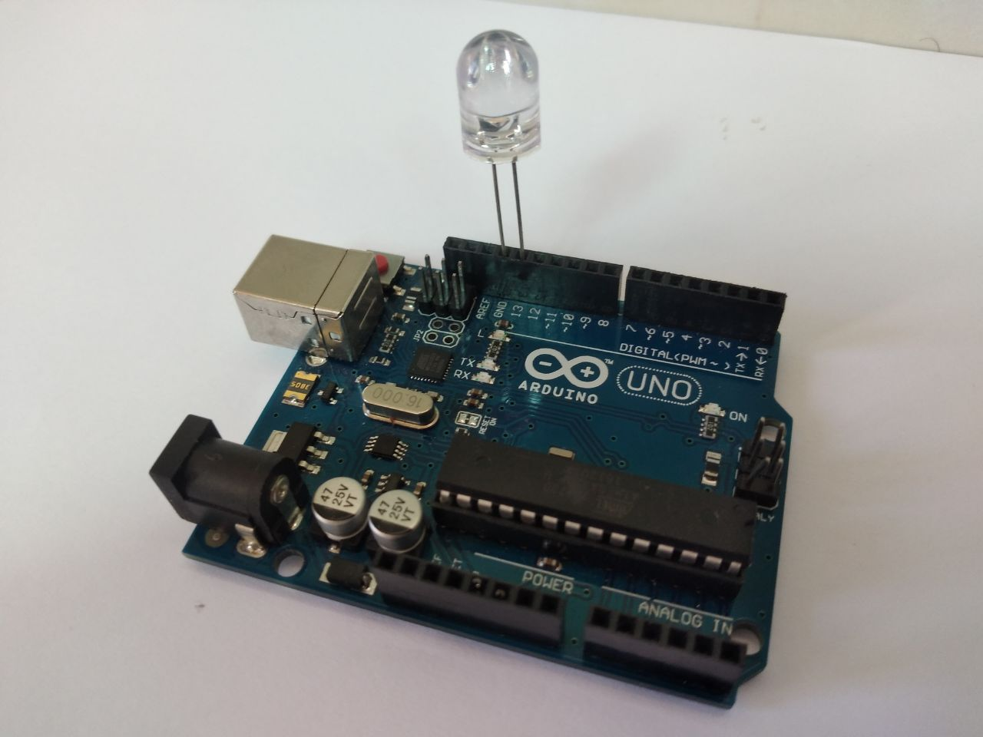
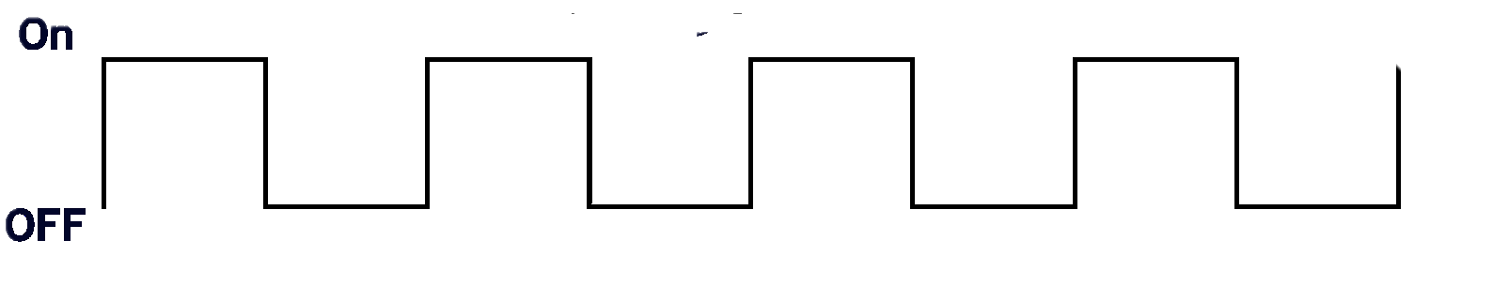
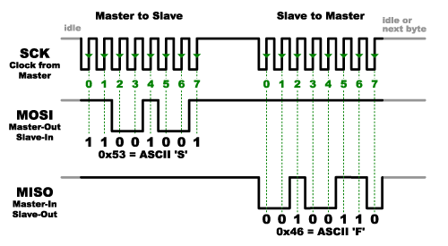
What is Arduino
Capable of reading/writing signals
LED control

Slide 9
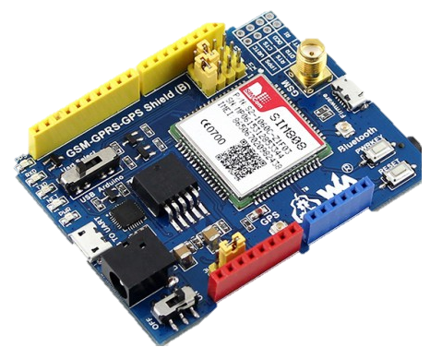
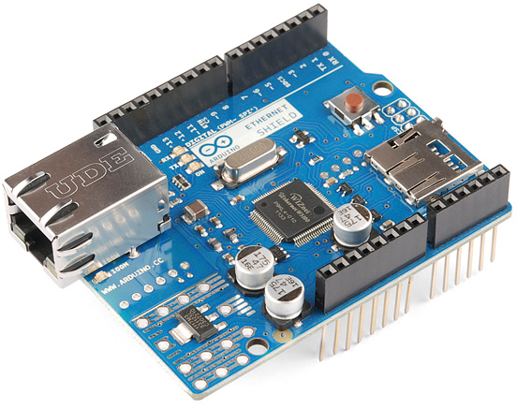
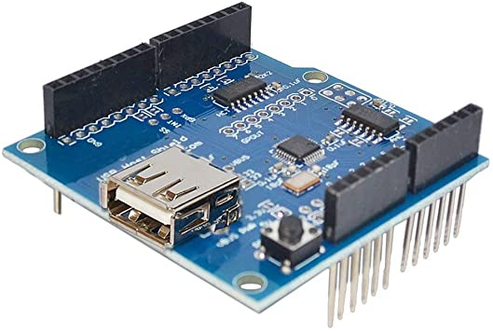
What is Arduino
Extendable ability using extension boards (shields)

Slide 10
Why Arduino Uno
Cheap
Simple to Use
Wide Online Community

Slide 11
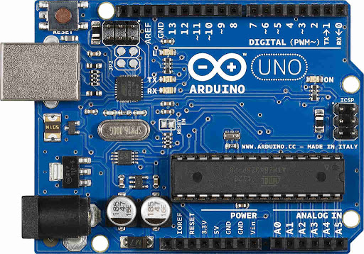
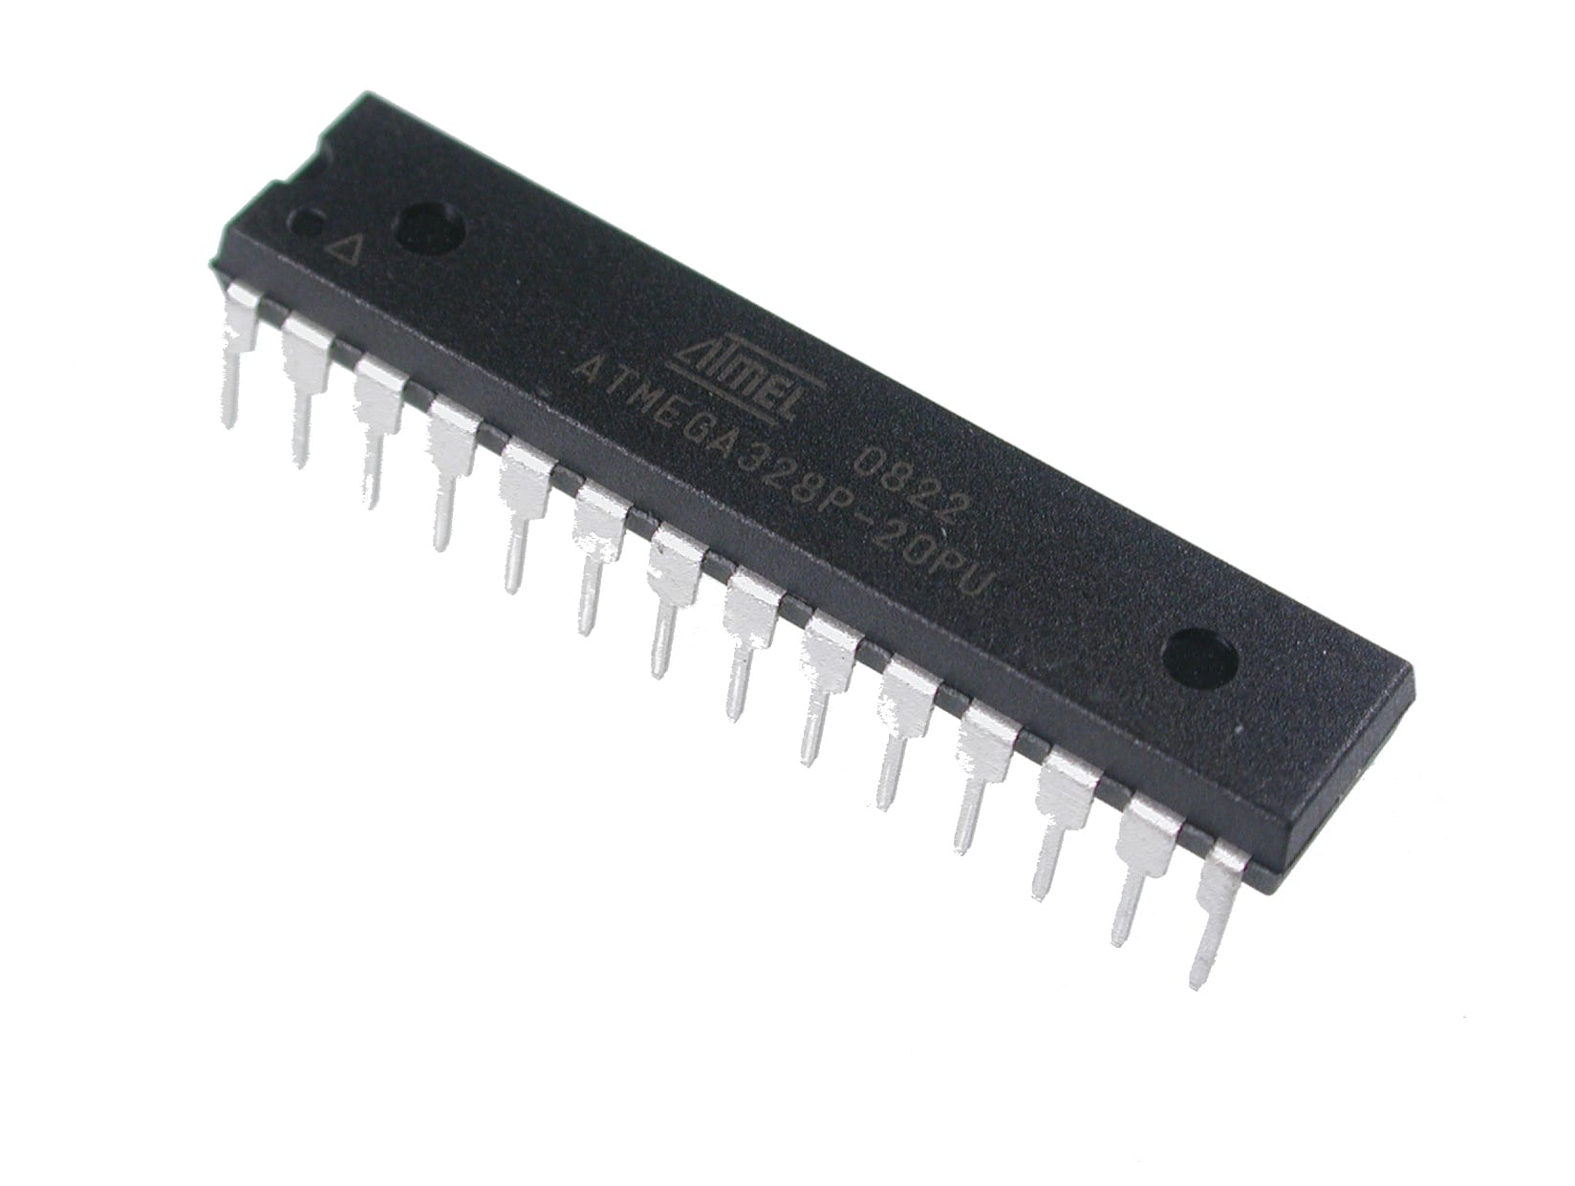
Arduino Uno Basic Layout
Digital I/O header w/PWM
Reset Button
Microcontroller
Atmega328/p
Power Header
Analog Input Header

Slide 12
Arduino Uno Board Indicators
On-Board Programmable LED
Power Indication LED
Serial Communication LED

Slide 13
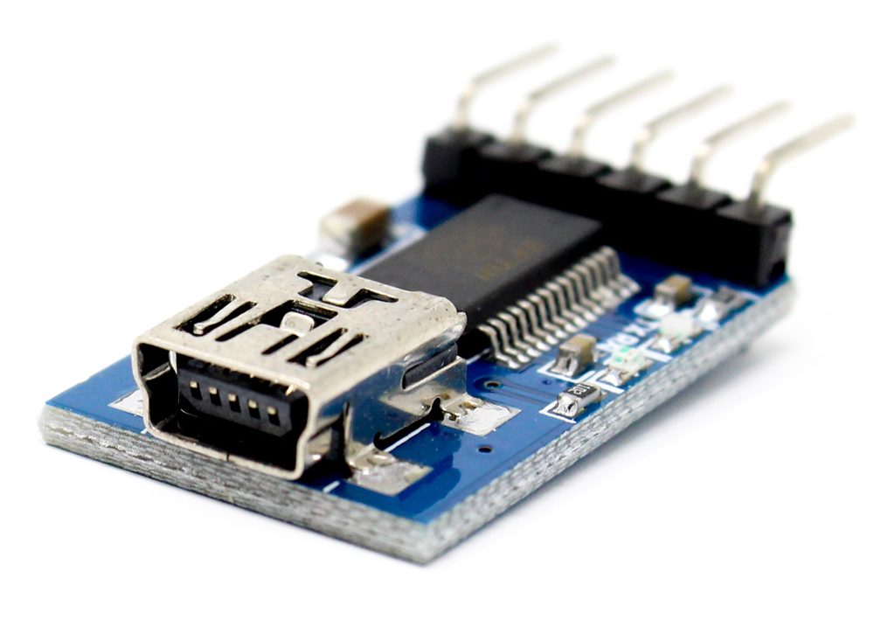
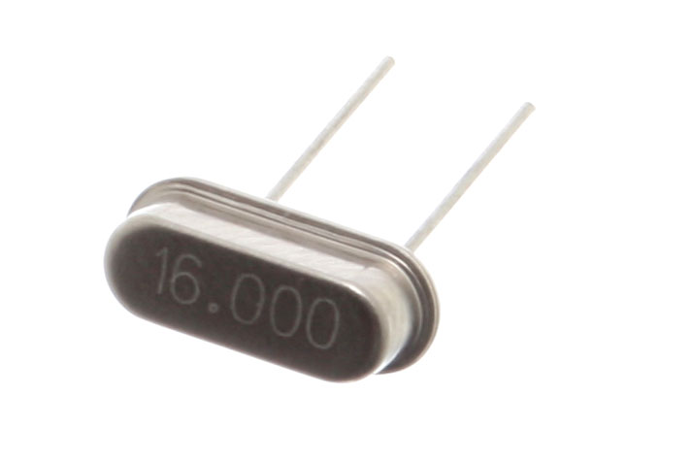
Arduino Uno Extensive Layout
ICSP Programming Header for USB/Serial Chip
ICSP Programming Header for Atmega328/p
USB/Serial Chip
Crystal Oscillator

Slide 14
Arduino Uno Extensive Layout
Power Management Circuitry

Slide 15
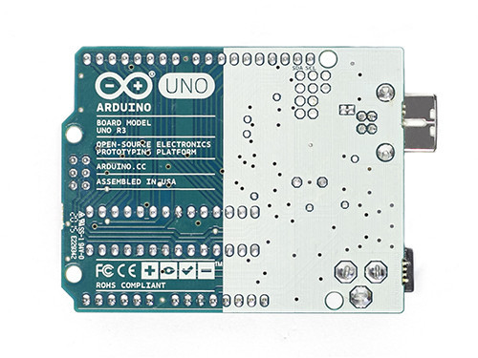
Arduino Uno Reverse Layout

Slide 16
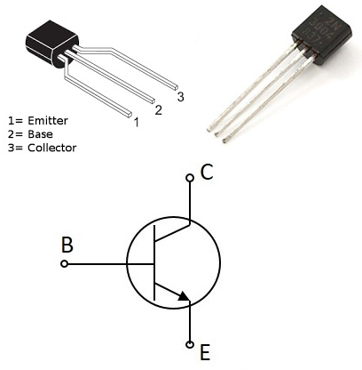
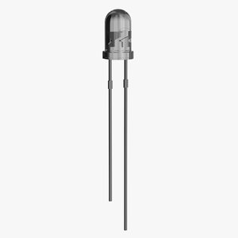
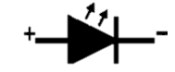
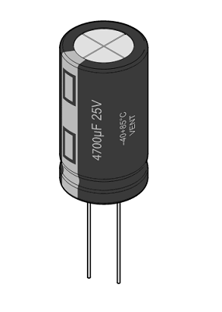
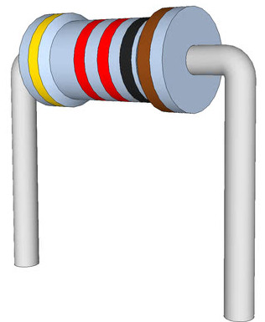
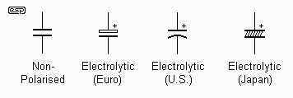
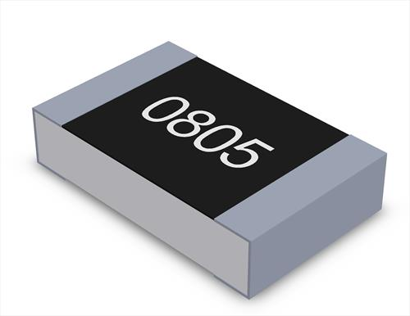
Overview of Electrical Components
Transistor
Light Emitting Diode
Capacitor

Slide 17
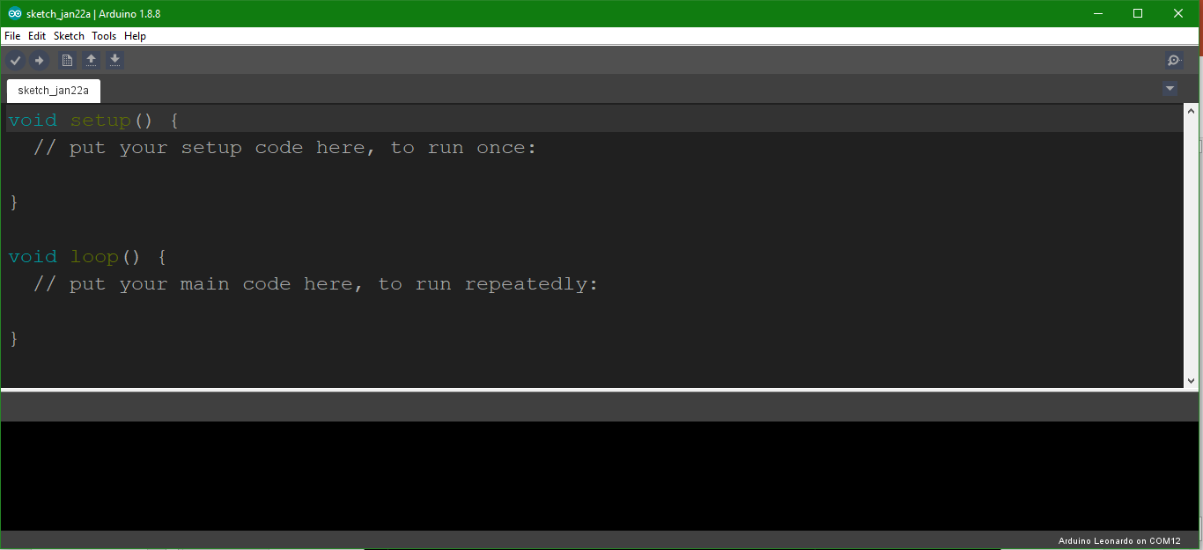
Setting Up Arduino IDE

Slide 18
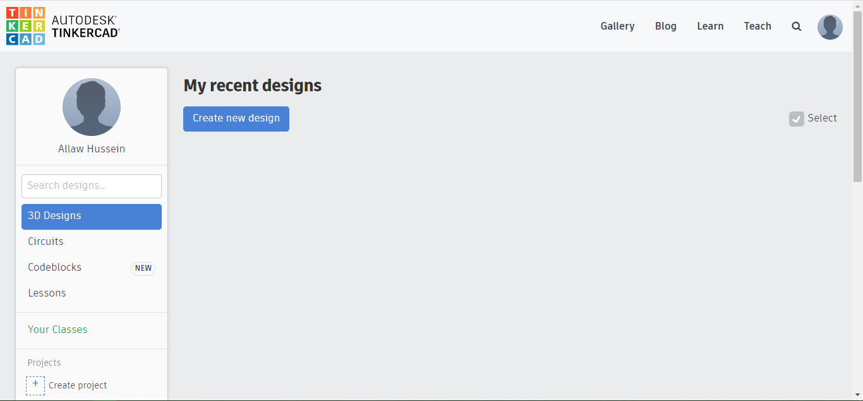
Setting Up Tinkercad

